Slide 1
Software Design and Architecture
Builder and Visitor Patterns

Slide 2
Design principles
High-level principles
‣ Single Responsibility
‣ Open/Closed
‣ Liskov Substitution Principle
‣ Interface Segregation
‣ Dependency Inversion
Low-level principles
‣ Encapsulate what varies
‣ Program to interfaces, not implementations
‣ Favor composition over inheritance
‣ Strive for loose coupling

Slide 3
Builder
Behavioral Patterns
observer
strategy
command
Template
null object
state
iterator
Creational Patterns
factory method
abstract factory
singleton
builder
Structural Patterns
decorator
adapter
façade
composite
bridge

Slide 4
Problem
We want to isolate implementation of a complex object, so that its construction process is the same as of another complex object.

Slide 5
Example
/** "Product" */
class Pizza {
private String dough = "";
private String sauce = "";
private String topping = "";
public void setDough(String dough) {
this.dough = dough; }
public void setSauce(String sauce) {
this.sauce = sauce; }
public void setTopping(String topping) {
this.topping = topping; }
}
Create HawaiianPizza
Pizza pizza;
pizza.setDough("cross");
pizza.setSauce("mild");
pizza.setTopping("ham+pineapple");

Slide 6
Example
/** "Product" */
class Pizza {
private String dough = "";
private String sauce = "";
private String topping = "";
public void setDough(String dough) {
this.dough = dough; }
public void setSauce(String sauce) {
this.sauce = sauce; }
public void setTopping(String topping) {
this.topping = topping; }
}
Create SpicyPizza
Pizza pizza;
pizza.setDough("pan baked");
pizza.setSauce("hot"); pizza.setTopping("pepperoni+salami");

Slide 7
Example
Create HawaiianPizza
Pizza pizza;
pizza.setDough("cross");
pizza.setSauce("mild");
pizza.setTopping("ham+pineapple");
Create SpicyPizza
Pizza pizza;
pizza.setDough("pan baked");
pizza.setSauce("hot"); pizza.setTopping("pepperoni+salami");
We want to separate HawaiianPizza and SpicyPizza from their implementations. So that the same construction process can create different pizzas (representations).

Slide 8
Builder Pattern
Separates the construction of a complex object from its representation so that the same construction process can create different representations.

Slide 9
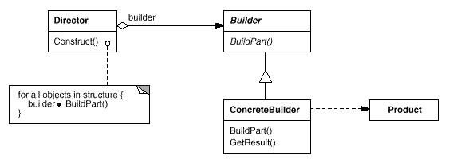
Class Diagram
Builder - specifies an abstract interface for creating parts of a Product object.
ConcreteBuilder - constructs and assembles parts of the product by implementing the Builder interface. Also, it defines and keeps track of the representation it creates and provides an interface for retrieving the product .
Director - constructs an object using the Builder interface.
Product - represents the complex object under construction.

Slide 10
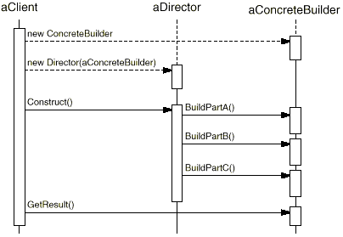
Sequence Diagram
The client creates the Director object and configures it with the desired Builder object.
Director notifies the builder whenever a part of the product should be built.
Builder handles requests from the director and adds parts to the product.
The client retrieves the product from the builder.

Slide 11
Pizza Builder Solution
/** "Product" */
class Pizza {
private String dough = "";
private String sauce = "";
private String topping = "";
public void setDough(String dough) {
this.dough = dough; }
public void setSauce(String sauce) {
this.sauce = sauce; }
public void setTopping(String topping) {
this.topping = topping; }
}

Slide 12
Pizza Builder Solution
/** "Abstract Builder" */
abstract class PizzaBuilder {
protected Pizza pizza;
public Pizza getPizza() {
return pizza; }
public void createNewPizzaProduct() {
pizza = new Pizza(); }
public abstract void buildDough();
public abstract void buildSauce();
public abstract void buildTopping();
}

Slide 13
Pizza Builder Solution
/** "ConcreteBuilder" */
class HawaiianPizzaBuilder extends PizzaBuilder {
public void buildDough() {
pizza.setDough("cross"); }
public void buildSauce() {
pizza.setSauce("mild"); }
public void buildTopping() {
pizza.setTopping("ham+pineapple"); }
}
/** "ConcreteBuilder" */
class SpicyPizzaBuilder extends PizzaBuilder {
public void buildDough() {
pizza.setDough("pan baked"); }
public void buildSauce() {
pizza.setSauce("hot"); }
public void buildTopping() {
pizza.setTopping("pepperoni+salami"); }
}

Slide 14
Pizza Builder Solution
/** "Director" */
class Waiter {
private PizzaBuilder pizzaBuilder;
public void setPizzaBuilder(PizzaBuilder pb) {
pizzaBuilder = pb; }
public Pizza getPizza() {
return pizzaBuilder.getPizza(); }
public void constructPizza() {
pizzaBuilder.createNewPizzaProduct();
pizzaBuilder.buildDough();
pizzaBuilder.buildSauce();
pizzaBuilder.buildTopping();
}
}

Slide 15
Pizza Builder Solution
/** A customer ordering a pizza. */
class BuilderExample {
public static void main(String[] args) {
Waiter waiter = new Waiter();
PizzaBuilder hawaiianPizzaBuilder = new HawaiianPizzaBuilder();
PizzaBuilder spicyPizzaBuilder = new SpicyPizzaBuilder();
waiter.setPizzaBuilder( hawaiianPizzaBuilder );
waiter.constructPizza();
Pizza pizza = waiter.getPizza();
}
}

Slide 16
Visitor
Behavioral Patterns
observer
strategy
command
template
state
iterator
visitor
Creational Patterns
factory method
abstract factory
singleton
builder
Structural Patterns
decorator
adapter
façade
composite
bridge

Slide 17
Problem
We want to perform new operations on concrete classes and we don’t want to “pollute” the classes with these operations.

Slide 18
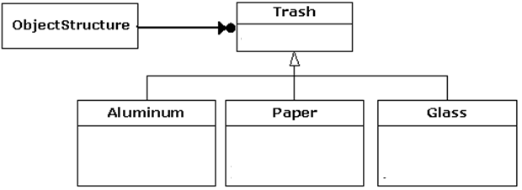
Example

Slide 19
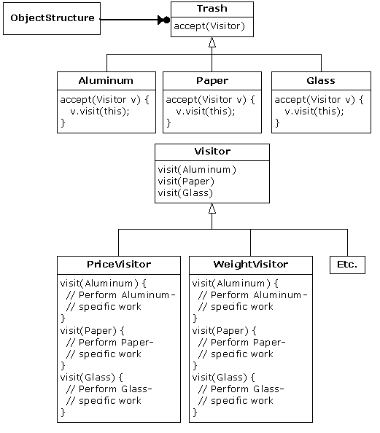
Example

Slide 20
Visitor Pattern
Allows for one or more operation to be applied to a set of objects at runtime, decoupling the operations from the object structure.

Slide 21
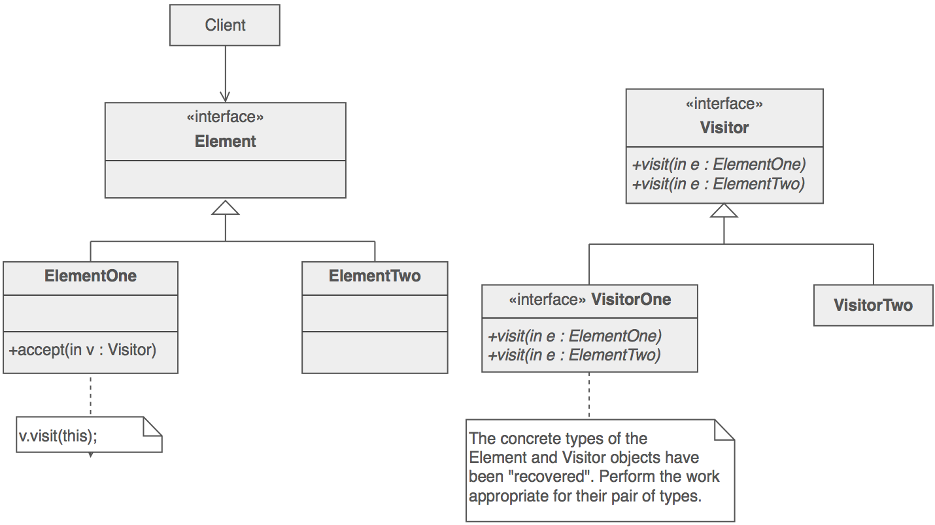
Class Diagram

Slide 22
Participants
Visitor – declares a visit operation for each class of ConcreteElement in the object structure
ConcreteVisitor – implements each operation declared by Visitor
Element – defines an Accept operation that takes a visitor as an argument
ConcreteElement – implements an Accept operation that takes a visitor as an argument

Slide 23
An Example
abstract class Parent { abstract void whoAmI();
}
class Child1 extends Parent { void whoAmI() {
print(“Child1”);
}
}
class Child2 extends Parent { void whoAmI() {
print(“Child2”);
}
}
create a visitor for
method whoAmI()
public static void main(String[] args) {
Child1 c1 = new Child1();
c1.whoAmI();
Child2 c2 = new Child2();
c2.whoAmI();
}

Slide 24
A Solution
abstract class Parent { abstract void accept(WamIVisitor v);
}
class Child1 extends Parent { void accept(WamIVisitor v) {
v.visit(this); }
}
class Child2 extends Parent { void accept(WamIVisitor v) {
v.visit(this); }
}
class WamIVisitor
static WamIVisitor instance =
new WamIVisitor();
void visit(Child1 c) {
print(“Child1”);
}
void visit(Child2 c) {
print(“Child2”);
}
}
public static void main(String[] args) {
Child1 c1 = new Child1();
c1.accept(WamIVisitor.instance);
Child2 c2 = new Child2();
c2.accept(WamIVisitor.instance);
}

